Slide 1
Design and Analysis of Algorithm Divide and Conquer strategy (Heap Sort)

Slide 2
Overview
• O(n lg n) worst case-like merge sort.
• Sorts in place-like insertion sort.
• Combines the best of both algorithms.

Slide 3
Heap data structure

Slide 4
Example

Slide 5
Example
Given an array of size N. The task is to sort the array elements by using Heap Sort.
Input:
N=10
Arr[]:{16, 4, 10, 14, 7, 9, 3, 2, 8, 1}
Output: 1 2 3 4 7 8 9 10 14 16

Slide 6
Example
Given an array of size N. The task is to sort the array elements by using Heap Sort.
Input:
N = 10
arr[] = {10,9,8,7,6,5,4,3,2,1}
Output:1 2 3 4 5 6 7 8 9 10

Slide 7
Heap property
For max-heaps (largest element at root), max-heap property: for all nodes i ,
excluding the root, A[PARENT(i )] ≥ A[i ].
For min-heaps (smallest element at root), min-heap property: for all nodes i ,
excluding the root, A[PARENT(i )] ≤ A[i ].

Slide 8
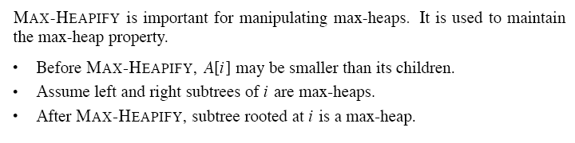
Maintaining the heap property

Slide 10
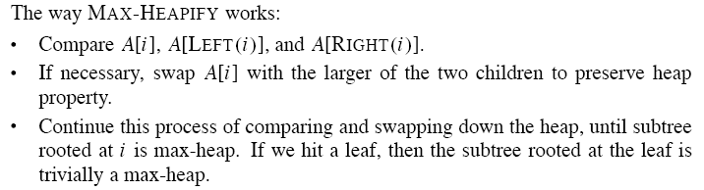

Slide 12
Building a heap

Slide 13
Example
Building a max-heap from the following unsorted array results in the
first heap example.

Slide 15
Correctness
Initialization:
Initialization: we know that each node . . . , n is a leaf, which is the root of a trivial max-heap. Since i = before the first iteration of the for loop, the invariant is initially true.
Maintenance: Children of node i are indexed higher than i , so by the loop invariant, they are both roots of max-heaps. Correctly assuming that i+1, i+2, . . . , n are all roots of max-heaps, MAX-HEAPIFY makes node i a max-heap root. Decrementing i re-establishes the loop invariant at each iteration.
Termination: When i = 0, the loop terminates. By the loop invariant, each node, notably node 1, is the root of a max-heap.

Slide 16
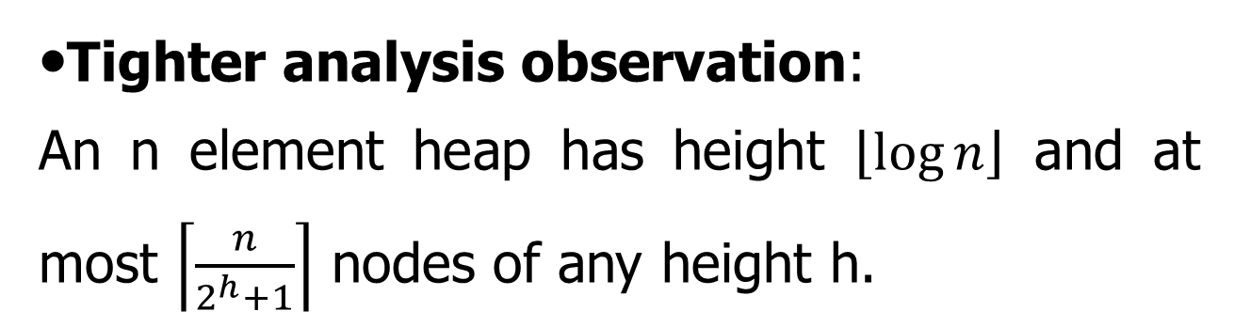
Analysis
• Simple bound: O(n) calls to MAX-HEAPIFY, each of which takes O(lg n) time ⇒ O(n lg n).
•Tighter analysis observation:
An n element heap has height $\left\lfloor \log{n}\right\rfloor$ and at most $\left\lceil \frac{n}{2^{h}+1}\right\rceil$ nodes of any height h.

Slide 17
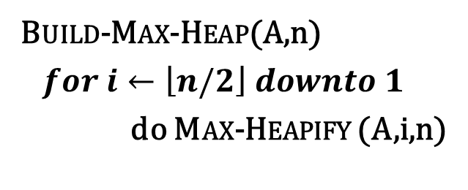
Tighter analysis Proof
Build-Max-Heap(A,n)
$for i←\left\lfloor n/2\right\rfloor downto 1$
do Max-Heapify (A,i,n)
9
6
5
i
0
8
2
1
1 | 2 | 3 | 4 | 5 | 6 | 7 | 8
9 | 6 | 5 | 0 | 8 | 2 | 1 | 3
3

Slide 18
Tighter analysis Proof
For easy understanding, Let us take a complete binary Tree,
The height of a node is the number of edges from the node to the deepest leaf.
The depth of a node is the no of edges from the root of the node.

Slide 19
Tighter analysis Proof
All the leaves are of height 0, therefore there are 8 nodes at height 0.
4 numbers of nodes at height 1.
2 numbers of nodes at height 2.
and one node at height 3.

Slide 20
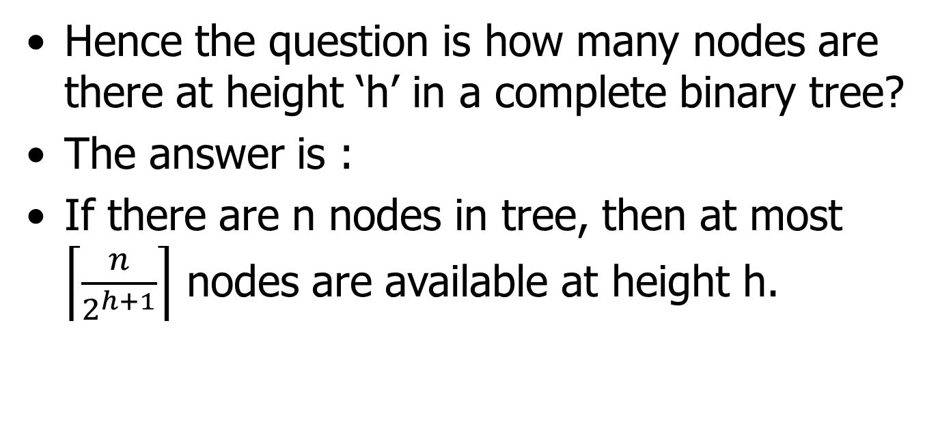
Tighter analysis Proof
Hence the question is how many nodes are there at height ‘h’ in a complete binary tree?
The answer is :
If there are n nodes in tree, then at most $\left\lceil \frac{n}{2^{h+1}}\right\rceil$ nodes are available at height h.

Slide 21
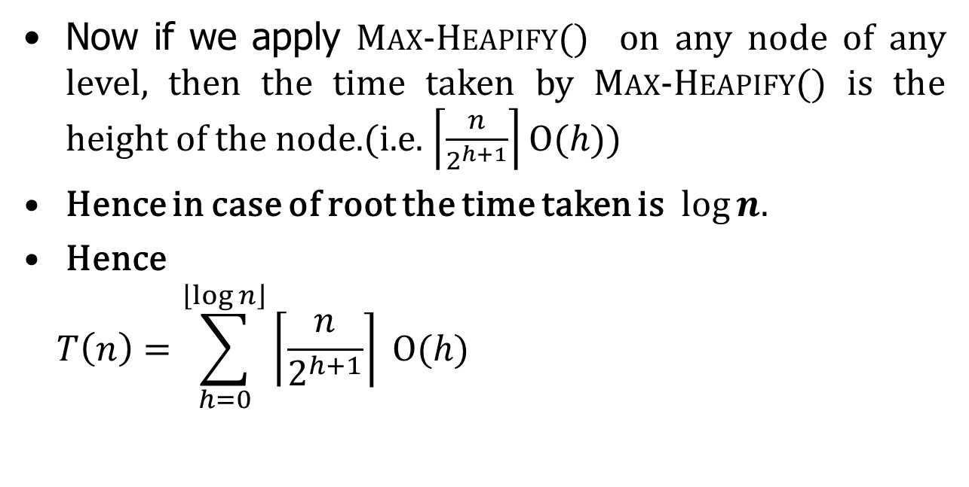
Tighter analysis Proof
Now if we apply Max-Heapify() on any node of any level, then the time taken by Max-Heapify() is the height of the node.(i.e. $\left\lceil \frac{n}{2^{h+1}}\right\rceil Ο(h)$)
Hence in case of root the time taken is $log⁡n.$
Hence
$$T\left(n\right)=\sum_{h=0}^{\left\lfloor \log{n}\right\rfloor }{\left\lceil \frac{n}{2^{h+1}}\right\rceil }Ο(h)$$
Work done by Max-Heapify() on the number of nodes of height h.

Slide 22
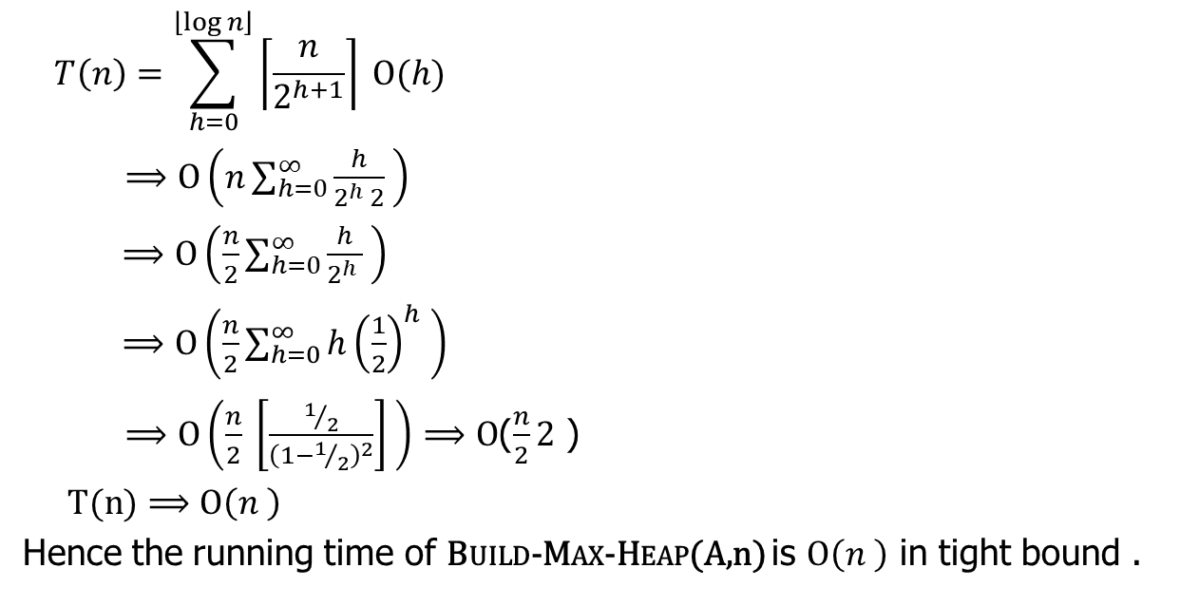
Tighter analysis Proof
This is a Harmonic Series. By Integrating and Differentiating the series we get the value is 2.
(Refer to next slide or cormen Appendix A.8)
$$T\left(n\right)=\sum_{h=0}^{\left\lfloor \log{n}\right\rfloor }{\left\lceil \frac{n}{2^{h+1}}\right\rceil }Ο(h)$$
$⟹Ο\left(n\sum_{h=0}^{∞}{\frac{h}{2^{h} 2} }\right)$
$⟹Ο\left(\frac{n}{2}\sum_{h=0}^{∞}{\frac{h}{2^{h} } }\right)$
$⟹Ο\left(\frac{n}{2}\sum_{h=0}^{∞}{h{\left(\frac{1}{2}\right)}^{h} }\right)$
$⟹Ο\left(\frac{n}{2} \left[\frac{1/2}{{\left(1−1/2\right)}^{2}}\right] \right)$ $⟹Ο$($\frac{n}{2}2$ )
$T(n)⟹Ο\left(n \right)$
Hence the running time of Build-Max-Heap(A,n) is $Ο\left(n \right)$ in tight bound .

Slide 23

Tighter analysis Proof
$$\sum_{k=0}^{∞}{x^{k}=\frac{1}{1−x}} \left[value of Infanite G P Series\right]$$
$$\sum_{k=0}^{∞}{x^{k}={(1−x)}^{−1}}$$
Differentiate both side:
$$\sum_{k=0}^{∞}{{k.x}^{k−1}=\left(−1\right){\left(1−x\right)}^{−2}\left(−1\right)=\frac{1}{{(1−x)}^{2}}}$$
Multiply x both side
$$\sum_{k=0}^{∞}{{k.x}^{k}==\frac{x}{{(1−x)}^{2}}}$$

Slide 24
The heapsort algorithm
Given an input array, the heapsort algorithm acts as follows:
• Builds a max-heap from the array.
• Starting with the root (the maximum element), the algorithm places the maximum element into the correct place in the array by swapping it with the element in the last position in the array.
• “Discard” this last node (knowing that it is in its correct place) by decreasing the heap size, and calling MAX-HEAPIFY on the new (possibly incorrectly-placed) root.
• Repeat this “discarding” process until only one node (the smallest element) remains, and therefore is in the correct place in the array.

Slide 25
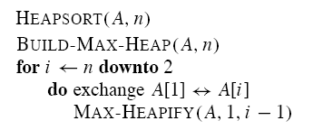

Slide 26
Example

Slide 27
Analysis
• BUILD-MAX-HEAP: O(n)
• for loop: n − 1 times
• exchange elements: O(1)
• MAX-HEAPIFY: O(lg n)
Total time: O(n lg n).

Slide 28
Finding the maximum element
Getting the maximum element is easy: it’s the root.
HEAP-MAXIMUM(A)
return A[1]
Time: (1).

